Slide 1
Voice Assistant(Veronica)
By Vikas Chaubey, Nikhil Ingle

Slide 2
What Voice Assistant (Veronica)
A voice assistant is a digital assistant that uses voice recognition, speech synthesis, and natural language processing (NLP) to provide a service through a particular application.
In general voice assistants react to voice commands and give the user relevant information about his inquiry. Presently voice assistants are already able to process orders of products, answer questions, perform actions like playing music or start a simple phone call with a friend.

Slide 3
How it Works
The software is the actual core of the artificial intelligence that enables the smart speaker or Smartphone to answer our specific questions and human commands.
Being able to understand and process our questions is the great challenge voice assistants have to master.
Meaning a voice assistant has to be able to learn and make use of languages to be able to pick the right answers to our commands

Slide 4
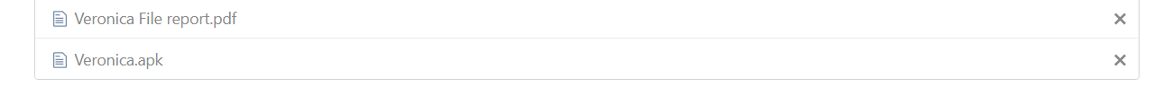
How to Install Veronica in your device
Step 1 : Veronica is android base app which you need android device you have select apk file from the project file or link below there .
Veronica app link
or
Project file link
https://drive.google.com/open?id=1mco9yEzT-KH1oPP7h4Gelw3y29fAR6xq

Slide 5
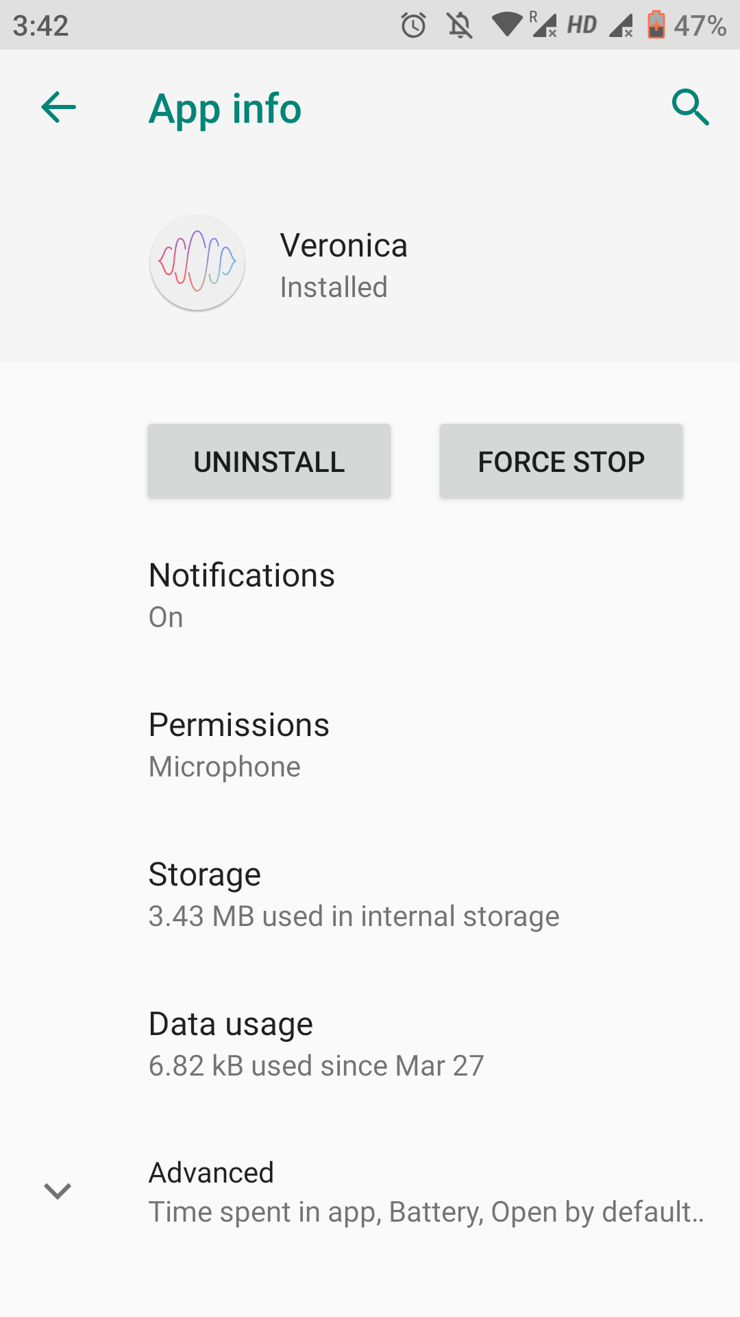
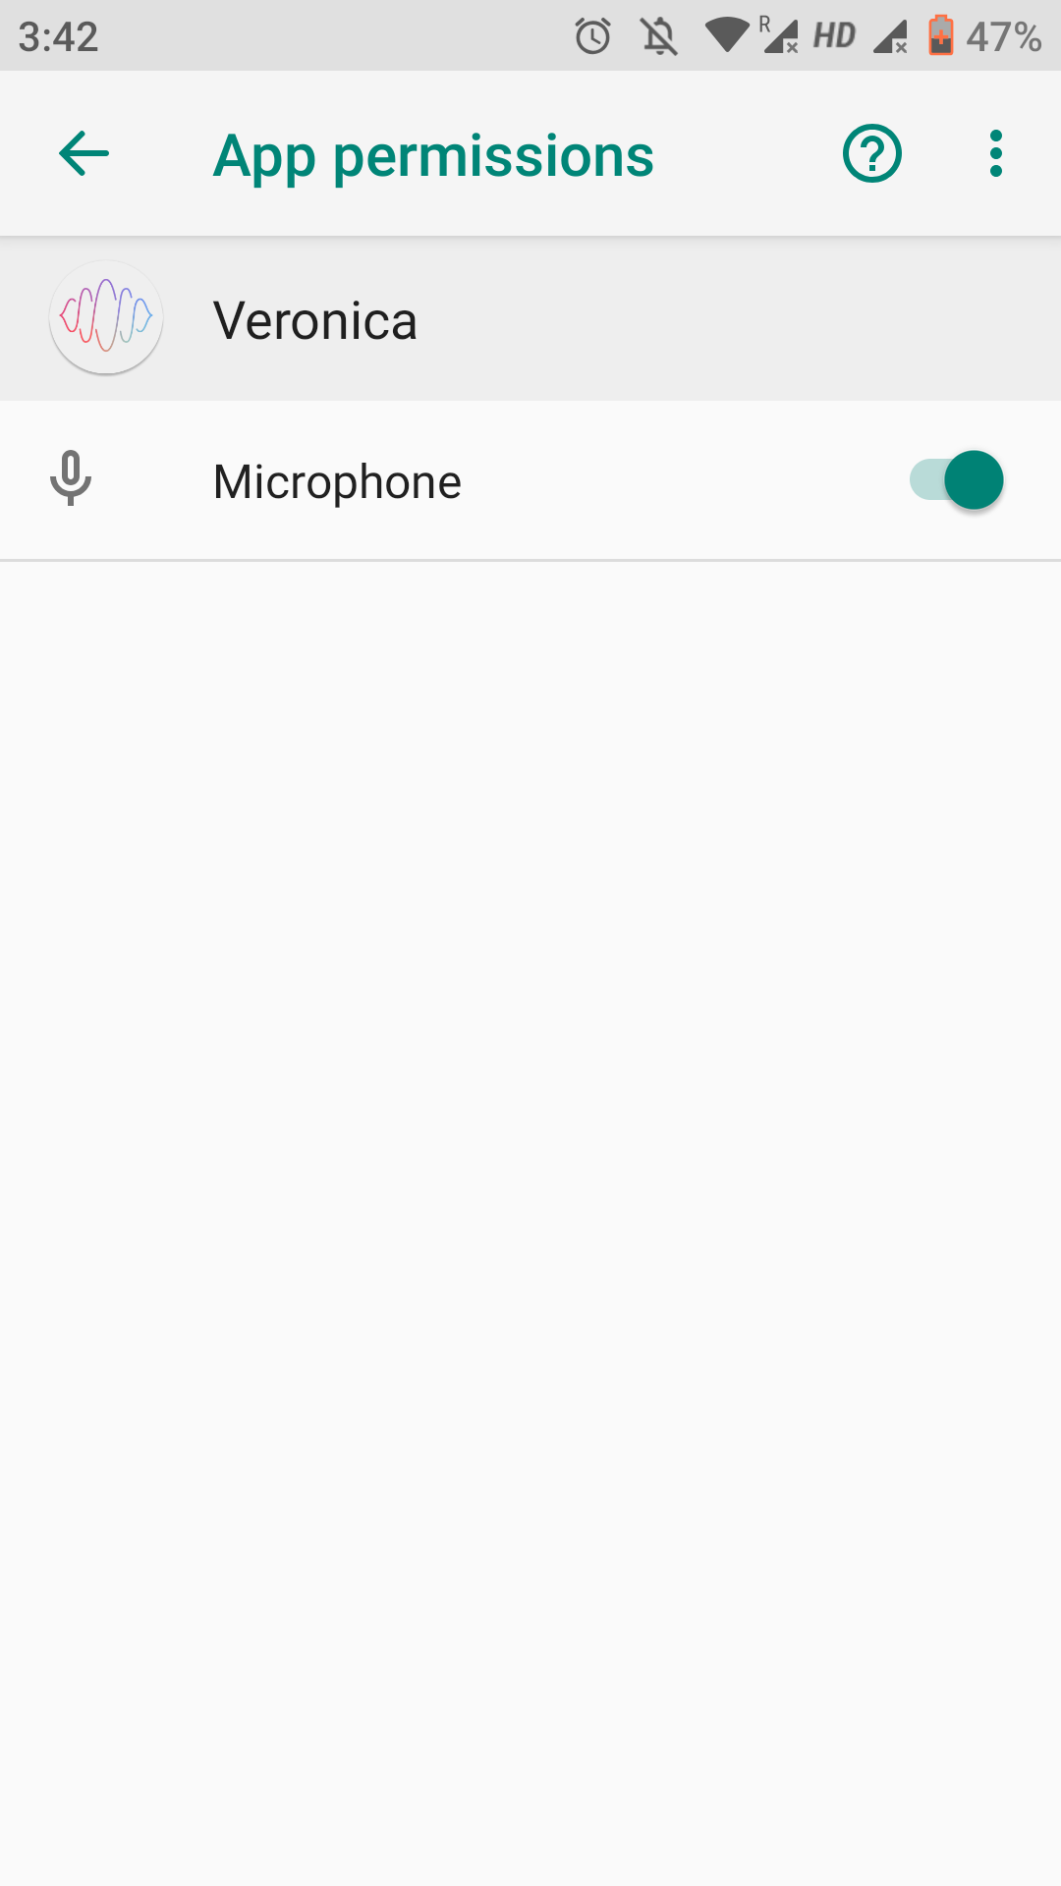
Step 2 : After Install it you have to allow the permission of you Smartphone like this

Slide 6
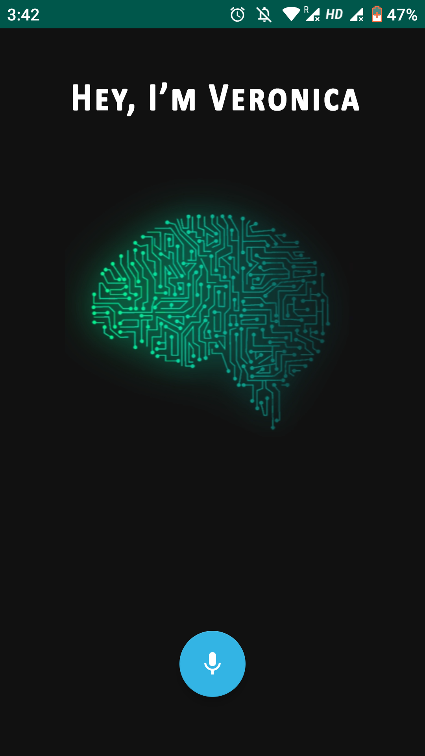
Step 3 : Tap the microphone icon for speak. Please wait for few second to response “Hey I’m Veronica How can I help you ” then you have to tap.
We have few commands so please say this only upgrading soon. The below down
What is your name
Who made you
tell me a joke
say hi to everyone
What is Time now

